Slide 1
Northwest Health Application

Slide 2
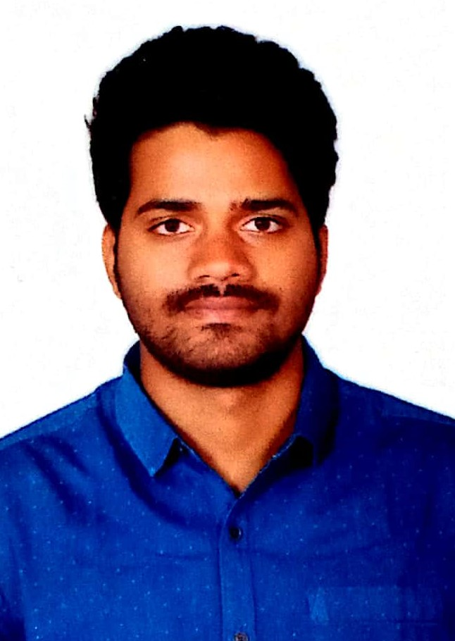
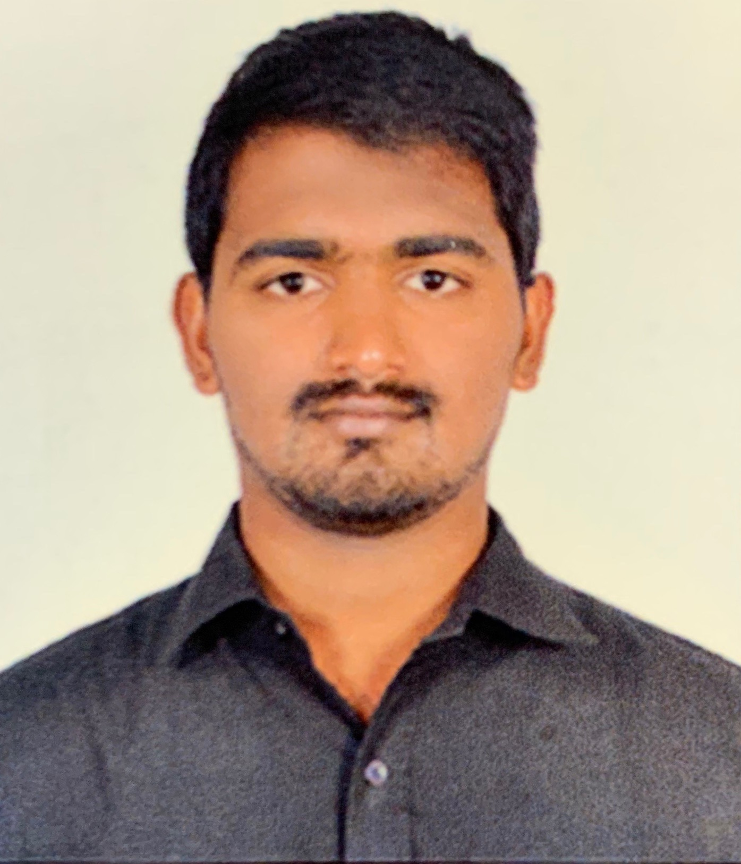
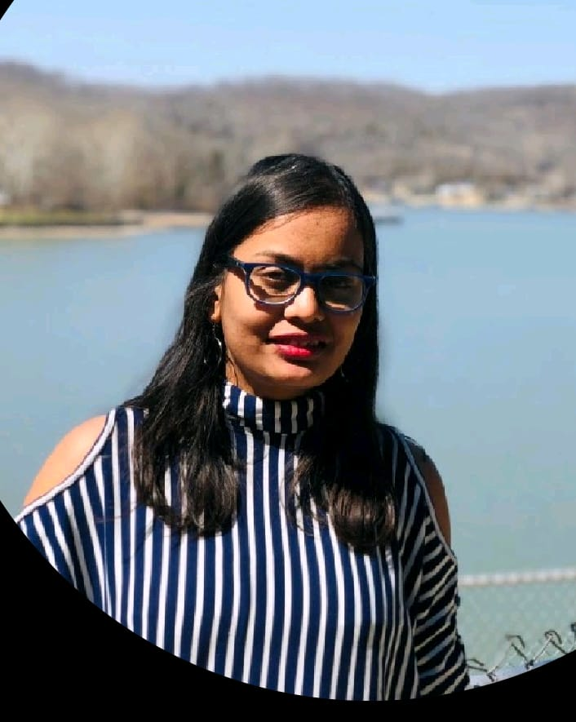
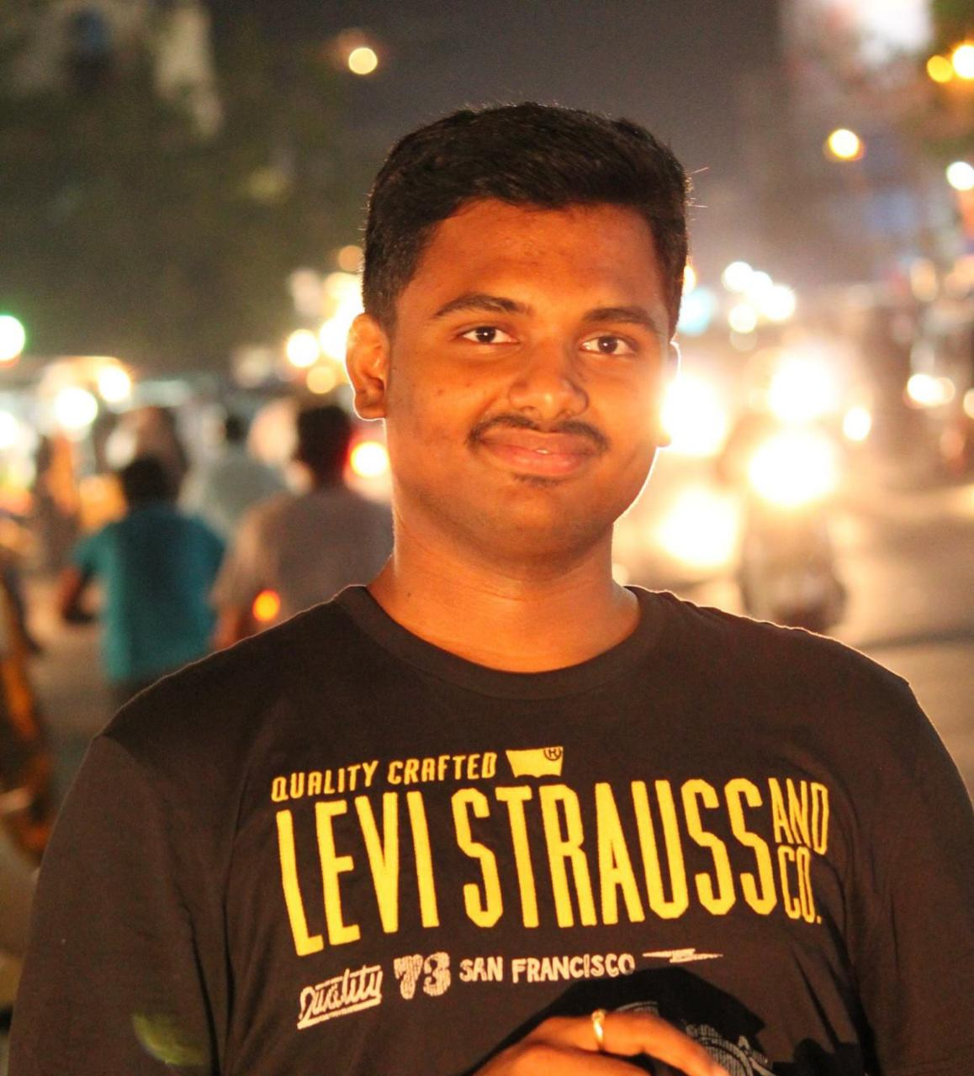
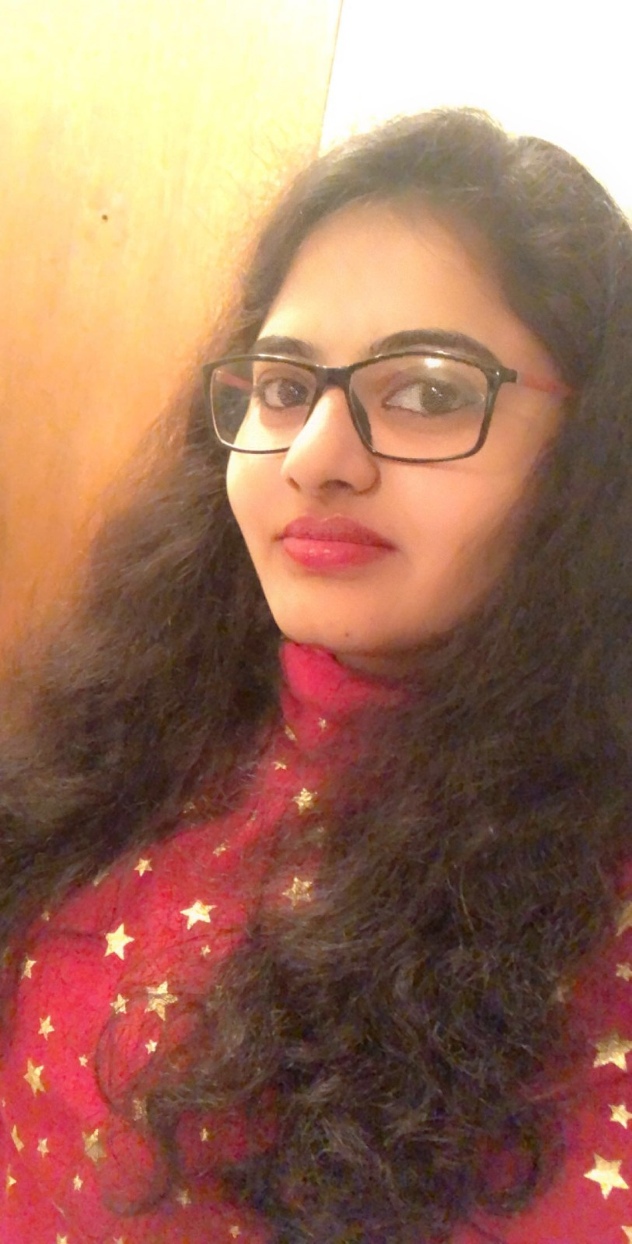
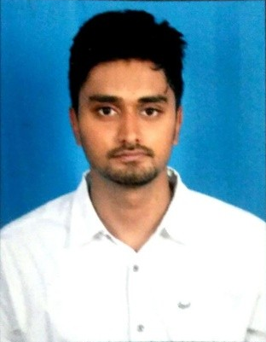
Health-App Team
WEB DEVELOPER
WEB DEVELOPER
DATABASE ADMIN
AKHIL KUMAR REDDY
YESHWANTH REDDY
SHARADRUTHI
ANDROID DEVELOPER
ANDROID DEVELOPER
ANDROID DEVELOPER
RUDRA TEJA
JASWANTHI
SAI NIKHIL

Slide 3
Topics To Be Covered
Technologies and Tools
What Accomplished Since Midterm
Most Significant Artifacts/Accomplishments
Application Demonstrations
Issues Encountered
Lessons Learned
Conclusion
Jaswanthi

Slide 4
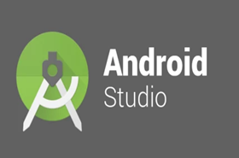
Tools used for Android App
Android Studio is a piece of software called an IDE (Integrated Development Environment)
It will come packaged with the Android SDK
Reference: https://techcrunch.com/2017/02/19/why-is-android-studio-still-such-a-gruesome-embarrassment/
3
Jaswanthi

Slide 5

Technology used by Android Studio -
JAVA
Java is the official language of Android development and supported by Android Studio
Reference: https://memorynotfound.com/convert-image-grayscale-java/
Jaswanthi
4

Slide 6
Tools and Technologies used for Web
Web development consists of front end as well as backend
Frontend is referred to as the “client-side”
For frontend we use HTML, CSS, Java Script, JQuery, Bootstrap
Backend development focuses on databases, scripting, and the architecture of websites
Jaswanthi
5

Slide 7
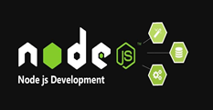
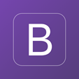
Tools and Technologies for Website Development
JavaScript is often abbreviated as JS, High level programming language enables interactive webpages which is an essential part of web applications
Bootstrap is an open source Web application development tool that’s used to build responsive designs
Reference: https://www.htmlgoodies.com/html5/markup/10-common-uses-of-bootstrap.html
Jaswanthi
6

Slide 8
What Accomplished Since Midterm
Android Application:
Completed the home page and profile page
Implemented the group activity page
Added some more code in firebase to store the data
Website:
Display users data in the website and to excel sheet
Adding users to a group
Delete users in a group and from the database
Sai Nikhil
7

Slide 9
Most Significant Artifacts/Accomplishments
Completed detailed documentation of the project
Use cases or user stories (Updated)
Database design
UI designs
Process flow diagrams
Implemented all the major tasks of android application and website
Implemented the changes recommended by the client
Sai Nikhil
8

Slide 10
DEMO

Slide 11
Issues Encountered
Android Application:
Working with the Firebase database
Implementing groups functionality
Designing the user interface
Website:
Retrieving user data
Implementing performance in graphs
Downloading user data to Excel file
Yeshwanth
9

Slide 12
Lessons Learned (Technical)
Learned to develop use case and UML diagrams
Usage of Adobe XD to develop prototypes for both Android and Web applications
Implementation of Firebase for data storage and retrieval
Performing usability testing for the Android application
Yeshwanth
10

Slide 13
Lessons Learned (Non technical)
Started using Health applications in our daily life
Learned to work with in a team and ourselves
How to build a good rapport with client
Dividing and balancing the work among teammates
Time management skills
Improved communication and social skills
2
Akhil
11

Slide 14
Conclusion
This app encourages people to focus on their Health and Wellness
Encourages work-life balance
Encourages healthy relationships between the users
Motivates each other with the challenges
Akhil
12

Slide 15
Thank you…

